Slide 1
COMBINATIONAL CIRCUITS
COMPUTER SYSTEM ARCHITECTURE
BY:
ROSHNI PATOA

Slide 2
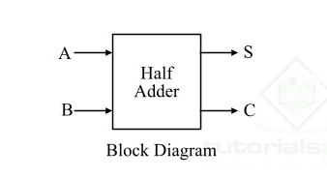
HALF ADDER
A half adder is a basic digital circuit
It performs addition of two binary digits
Has two inputs (A and B) and two outputs (Sum and Carry)
Key component in arithmetic operations in computers

Slide 3
Inputs and Outputs
Inputs: Two 1-bit binary numbers (A and B)
Outputs:
Sum (S): Result of A + B
Carry (C): Overflow bit when A + B > 1

Slide 4
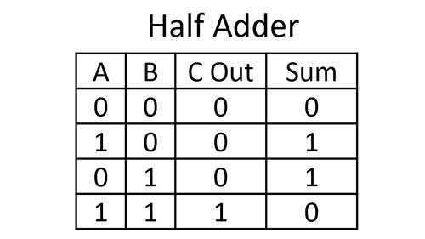
Truth Table for Half Adder

Slide 5
Logic Gates in Half Adder
XOR gate: Used for Sum output
AND gate: Used for Carry output

Slide 6
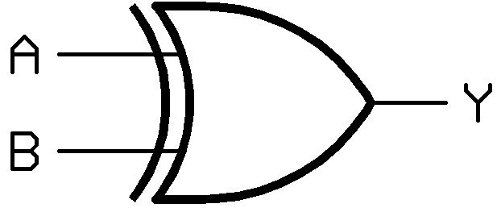
XOR GATE FOR SUM
XOR (Exclusive OR) gate used for Sum
Output is 1 if inputs are different
Output is 0 if inputs are same
Perfectly represents addition without carry

Slide 7

AND GATE FOR CARRY
AND gate used for Carry
Output is 1 only when both inputs are 1
Represents when addition results in a carry

Slide 8
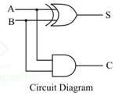
Half Adder Circuit Diagram
Inputs: A and B
XOR gate connected to both inputs, output is Sum
AND gate connected to both inputs, output is Carry

Slide 9
Example: Adding 0 + 0
Input A = 0, Input B = 0
XOR gate: 0 ⊕ 0 = 0 (Sum)
AND gate: 0 • 0 = 0 (Carry)
Result: Sum = 0, Carry = 0

Slide 10
Example: Adding 0 + 1
Input A = 0, Input B = 1
XOR gate: 0 ⊕ 1 = 1 (Sum)
AND gate: 0 • 1 = 0 (Carry)
Result: Sum = 1, Carry = 0

Slide 11
Example: Adding 1 + 0
Input A = 1, Input B = 0
XOR gate: 1 ⊕ 0 = 0 (Sum)
AND gate: 1 • 0 = 0 (Carry)
Result: Sum = 1, Carry = 0

Slide 12
Example: Adding 1 + 1
Input A = 1, Input B = 1
XOR gate: 1 ⊕ 1 = 0 (Sum)
AND gate: 1 • 1 = 1 (Carry)
Result: Sum = 0, Carry = 1

Slide 13
CONCLUSION
Half adders are fundamental to digital arithmetic
They combine XOR and AND gates for binary addition
Next steps: Explore full adders

